Slide 1


Department of Artificial Intelligence and Data Science
Admin Resource Allocation and Optimization
Dr. Suresh Kumar S M.E., Ph.D.,
SUBASHREE (2116231801173)
SANJAI SY (2116231801148)
PRAMETHA S (2116231801128)

Slide 2
Problem Statement and Motivation
Organizations often struggle with inefficient resource allocation, leading to:
Overallocation: Some departments or staff are overloaded, reducing productivity.
Underutilization: Others remain idle, wasting time and cost.
Motivation: Current methods are manual and inaccurate, unable to adapt to real-time changes or large-scale data. This project aims to build an automated, data-driven system using a big data pipeline to optimize resource usage, improve efficiency, and support better decision-making.

Slide 3
Existing System
Existing systems depend on manual planning and basic scheduling tools, which have major drawbacks:
Manual Allocation: Based on human judgment; prone to errors and inconsistency.
Simple Tools: Static spreadsheets or rule-based models that ignore workload patterns or special events.
These systems cannot process large datasets or predict future needs, resulting in inefficient and unbalanced resource use.

Slide 4
Objectives
The project focuses on turning administrative data into insights for better planning by:
Building a Big Data Pipeline using HDFS, Spark, and Hive to manage large data efficiently.
Cleaning and Integrating Data from multiple sources into a unified dataset.
Developing a Forecasting and Optimization Model using Prophet and
optimization algorithms.
Supporting Data-Driven Decisions through dashboards and KPIs for administrators.

Slide 5
Abstract
This project provides a scalable solution for Admin Resource Allocation and Optimization using a two-stage big data system on Databricks.
In Stage 1, Apache Spark integrates and cleans data from various sources using a Bronze/Silver/Gold model (similar to HDFS). In Stage 2, the refined data from Hive (Gold layer) is used to train a Prophet model to forecast resource needs and identify workload trends.
The system delivers optimized allocation plans and clear dashboards, helping administrators make efficient, data-driven decisions and improve overall performance.

Slide 6
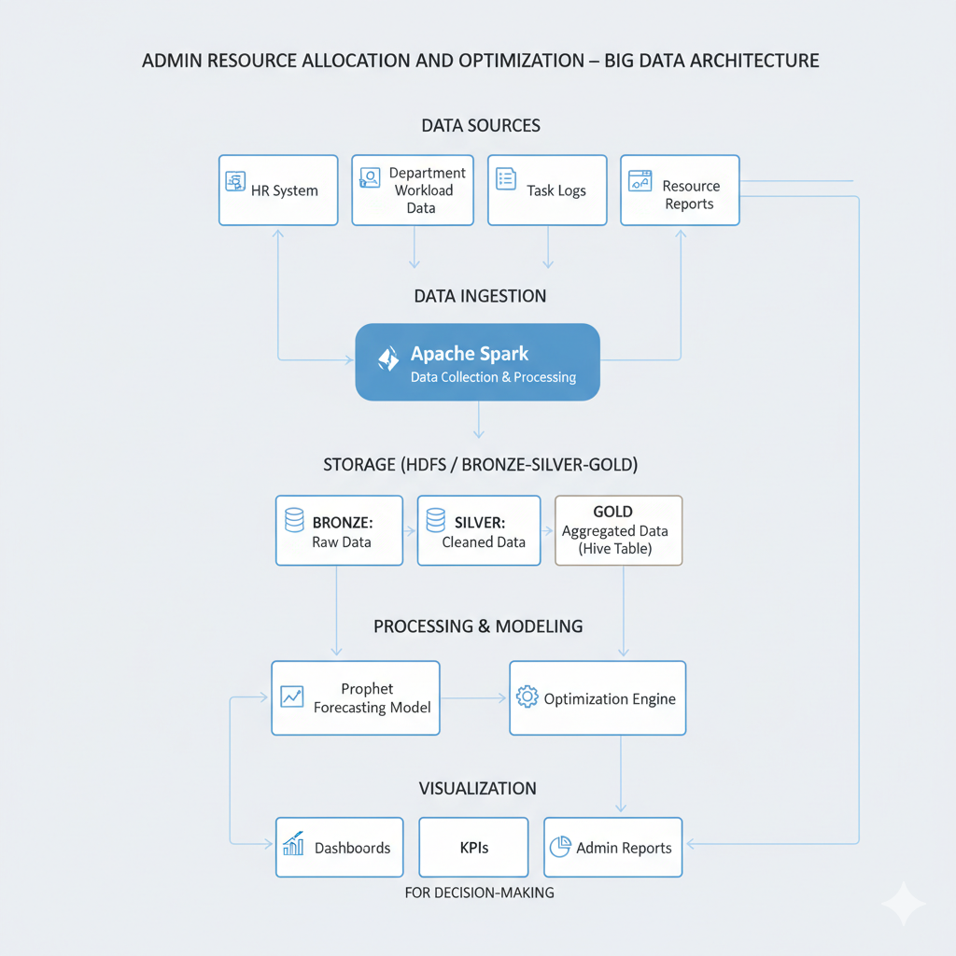
ARCHITECTURE DIAGRAM

Slide 7
Thank You

